Slide 1
Contingency Table,
Chi-square Test, and Logistic Regression

Slide 2
Chi-squared Test of Independence
Last Session and while doing the Chi-square test, we learned about the contingency table (Confusion Matrix), that actually is a joint frequency table.
We use the contingency table in the context of Disease Diagnosis to define a couple numerical indices.

Slide 3
Sensitivity, Specificity, PPV, NPV, etc.!
Sensitivity: shows the ability of a test to correctly identify patients with the disease.
Sensitivity is the proportion of people with the Disease that have a Positive test.
Sensitivity = TP/(TP+FN)
A test that is 100% sensitive means all diseased individuals are correctly identified as diseased i.e. there are no false negatives.
Specificity: shows the ability of a test to correctly identify people without the disease.
Specificity is the proportion of people without the Disease that have a Negative test.
Specificity = TN/(FP+TN)
A test that is 100% specific means all healthy individuals are correctly identified as healthy, i.e. there are no false positives.

Slide 4
Sensitivity, Specificity, PPV, NPV, etc.!
Positive Predictive Value (PPV)
The proportion of those with a Positive test that have the Disease.
This is the answer to the question: If I have a positive test, what is the likelihood I have the disease?
PPV = TP/(TP + FP)
Negative Predictive Value (NPV)
The proportion of those with a Negative test that do not have the Disease.
This is the answer to the question: If I have a negative test, what is the likelihood I do not have the disease?
NPV = TN/(FN + TN)

Slide 5
Example
For the above table, find Sensitivity, Specificity, PPV and NPV.

Slide 6
Sensitivity, Specificity, PPV, NPV, etc.! – Cont.
Test Accuracy is defined as
Accuracy = (TP +TN)/(P + N) = (TP + TN)/(TP + FP + TN + FN)
An estimation for Prevalence is given by
Prevalence = P/(P + N) = (TP + FN)/(TP + FP + TN + FN)

Slide 7
Logistic Regression
Recap: What is regression analysis?
Regression analysis is a mathematical/statistical tool to build a model that describes the relationship between two (or more) statistical variables.
Regression analysis allows us to model the variation of a statistical variable (response/dependent variable) vs. other variable(s) (estimator/independent variable).

Slide 8
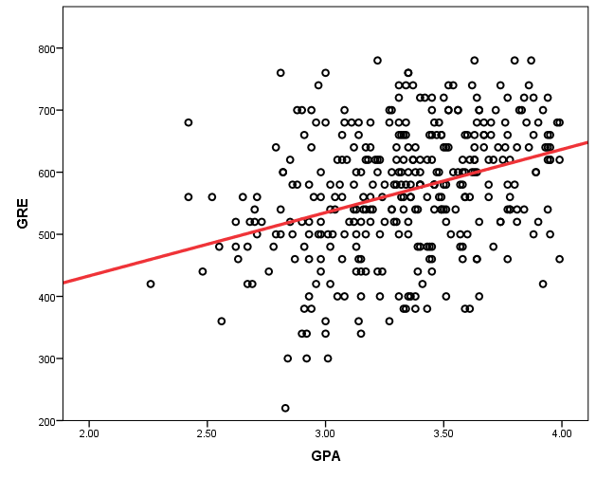
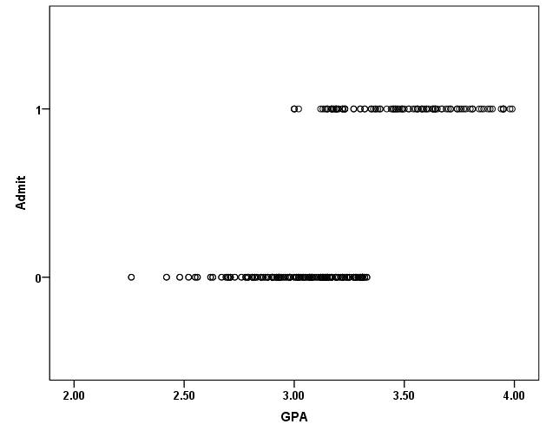
Logistic Regression – cont.
Logistic Regression is used when the dependent variable is binary i.e. gets only two values like 0 and 1, as apposed to when both dependent and independent variables are continuous.

Slide 9
Logistic Regression – cont.
The first step -perhaps- is to use the probability of the Binary event (death for instance) as the dependent variable instead of using the event itself. This means we use a variable that varies in between 0 and 1 (probability of death for instance), instead of a dichotomous variable death with values 0 and 1.
However, while probability is a continuous variable, it just ranges between 0 and 1. We therefore define Odd as in the next slide (that varies between 0 to infinity.

Slide 10
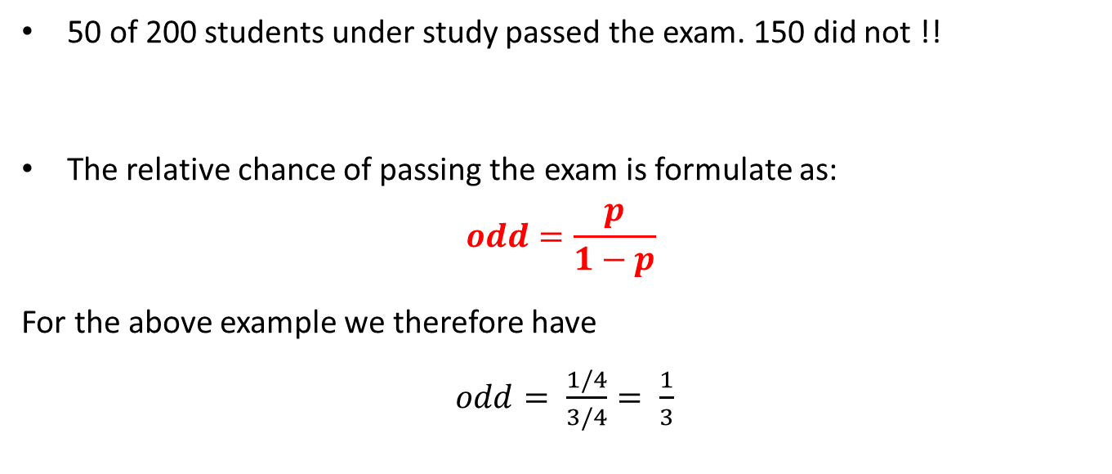
Probability and Odd
50 of 200 students under study passed the exam. 150 did not !!
The relative chance of passing the exam is formulate as:
$$odd=\frac{p}{1−p}$$
For the above example we therefore have
$odd= \frac{1/4}{3/4}= \frac{1}{3}$

Slide 11
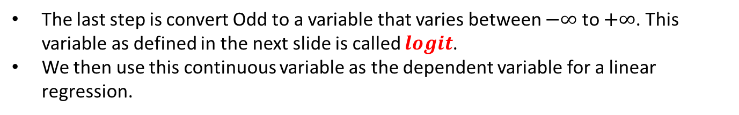
Probability and Odd – Cont.
The last step is convert Odd to a variable that varies between $−∞$ to $+∞$. This variable as defined in the next slide is called $logit$.
We then use this continuous variable as the dependent variable for a linear regression.

Slide 12

Logit
Logit is defined as
$$logit=ln \left(odd\right)=ln\left(\frac{p}{1−p}\right)$$
Therefore
$$odd=exp\left(logit\right)$$

Slide 13

Logit – cont.
Logit is defined as$logit=ln \left(odd\right)=ln\left(\frac{p}{1−p}\right)$.
As seen below, when $p$ varies between 0 and 1, logit varies between $−∞$ to $+∞$.

Slide 14
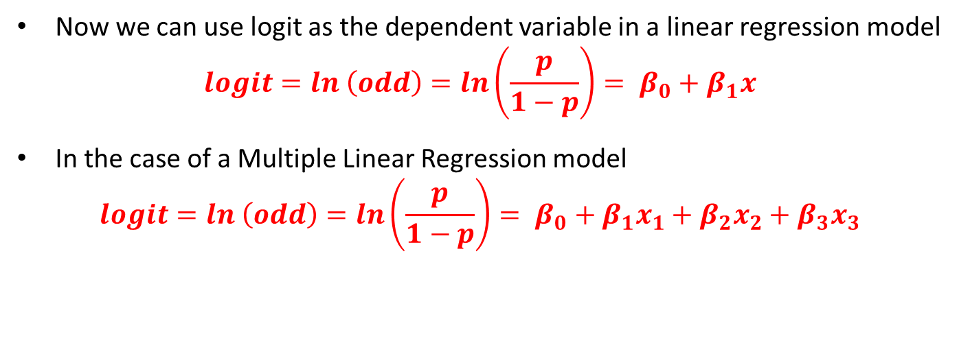
Formulation of Logistic Regression
Now we can use logit as the dependent variable in a linear regression model
$$logit=ln \left(odd\right)=ln\left(\frac{p}{1−p}\right)= β_{0}+β_{1}x$$
In the case of a Multiple Linear Regression model
$$logit=ln \left(odd\right)=ln\left(\frac{p}{1−p}\right)= β_{0}+β_{1}x_{1}+β_{2}x_{2}+β_{3}x_{3}$$

Slide 15
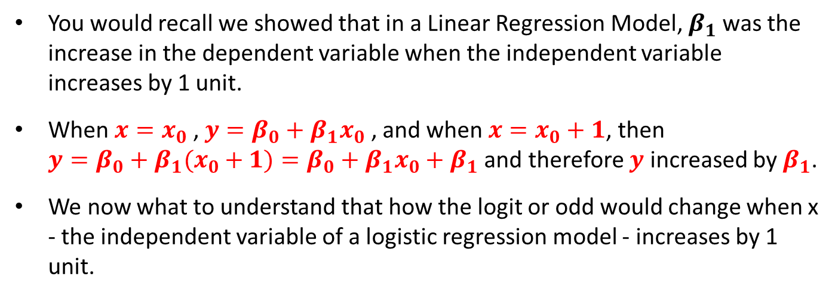

Interpretation of $β_{1}$
You would recall we showed that in a Linear Regression Model, $β_{1}$was the increase in the dependent variable when the independent variable increases by 1 unit.
When $x=x_{0}$ , $y={β_{0}+β_{1}x}_{0}$ , and when $x=x_{0}+1$, then $y={β_{0}+β_{1}(x}_{0}+1)=β_{0}+β_{1}x_{0}+β_{1}$ and therefore $y$ increased by $β_{1}$.
We now what to understand that how the logit or odd would change when x - the independent variable of a logistic regression model - increases by 1 unit.

Slide 16
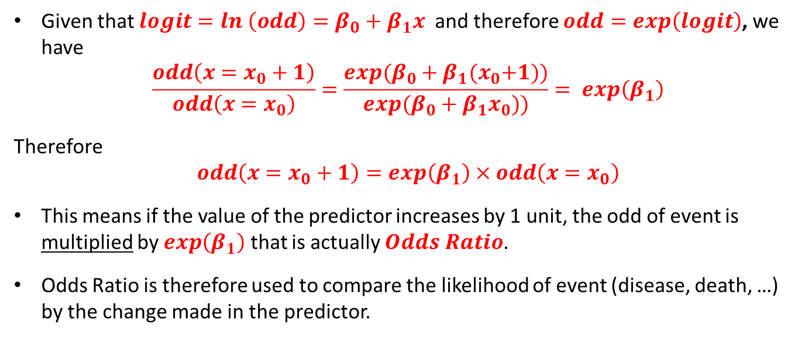
Interpretation of $β_{1}$- Odds Ratio
Given that $logit=ln \left(odd\right)=β_{0}+β_{1}x$ and therefore $odd=exp\left(logit\right)$, we have
$$\frac{odd\left(x=x_{0}+1\right)}{odd\left(x=x_{0}\right)}=\frac{exp⁡(β_{0}+β_{1}{(x}_{0}+1))}{exp⁡(β_{0}+β_{1}x_{0}))}= exp\left(β_{1}\right)$$
Therefore
$$odd\left(x=x_{0}+1\right)=exp\left(β_{1}\right)×odd\left(x=x_{0}\right)$$
This means if the value of the predictor increases by 1 unit, the odd of event is multiplied by $exp\left(β_{1}\right)$ that is actually $Odds Ratio$.
Odds Ratio is therefore used to compare the likelihood of event (disease, death, …) by the change made in the predictor.

Slide 17
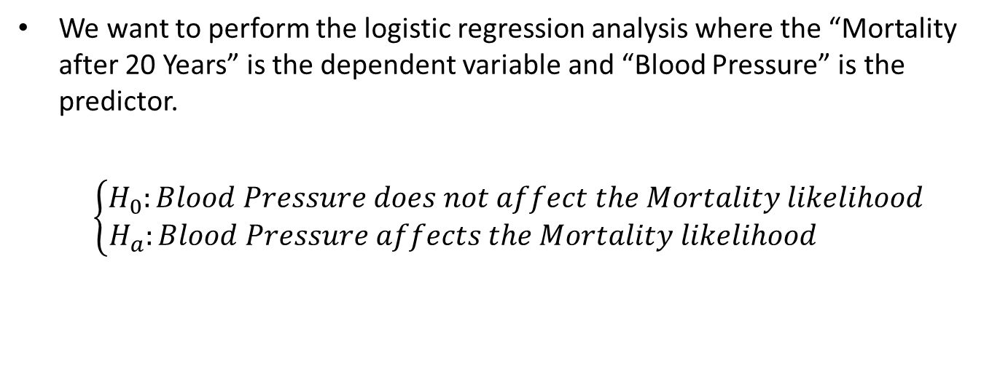
Example: Logistic Regression with Continuous Predictor
We want to perform the logistic regression analysis where the “Mortality after 20 Years” is the dependent variable and “Blood Pressure” is the predictor.
$$\left\{\begin{matrix}H_{0}:Blood Pressure does not affect the Mortality likelihood \\ H_{a}:Blood Pressure affects the Mortality likelihood \end{matrix}\right.$$

Slide 18
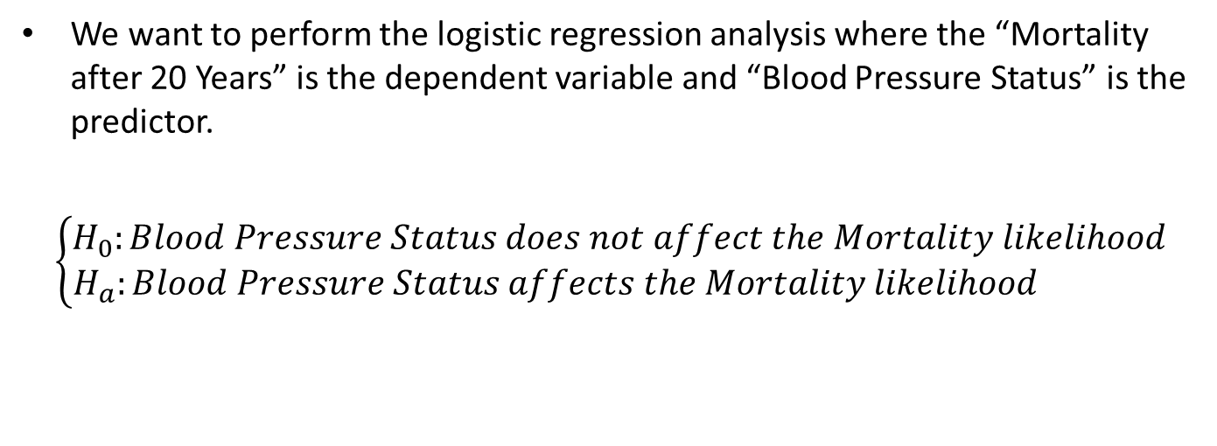
Example: Logistic Regression with Categorical Predictor
We want to perform the logistic regression analysis where the “Mortality after 20 Years” is the dependent variable and “Blood Pressure Status” is the predictor.
$$\left\{\begin{matrix}H_{0}:Blood Pressure Status does not affect the Mortality likelihood \\ H_{a}:Blood Pressure Status affects the Mortality likelihood \end{matrix}\right.$$

